Slide 1

Runs Test for Randomness

Slide 2
The runs test for randomness, which can be used to determine whether the sample data in a sequence are in a random order.
This test is based on sample data that have two characteristics, and it analyzes runs of those characteristics to determine whether the runs appear to result from some random process, or whether the runs suggest that the order of the data is not random.

Slide 3
Definition
A run is a sequence of data having the same characteristic; the sequence is preceded and followed by data with a different characteristic or by no data at all.
The runs test uses the number of runs in a sequence of sample data to test for randomness in the order of the data.

Slide 4
Fundamental Principles of the Run Test
Reject randomness if the number of runs is very low or very high.
Example: The sequence of genders FFFFFMMMMM is not random because it has only 2 runs, so the number of runs is very low.
Example: The sequence of genders FMFMFMFMFM is not random because there are 10 runs, which is very high.
It is important to note that the runs test for randomness is based on the order in which the data occur; it is not based on the frequency of the data.

Slide 5
Caution
The runs test for randomness is based on the order in which the data occur; it is not based on the frequency of the data. For example, a sequence of 3 men and 20 women might appear to be random, but the issue of whether 3 men and 20 women constitute a biased sample (with disproportionately more women) is not addressed by the runs test.

Slide 6
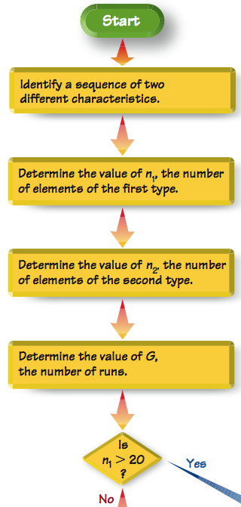
Procedure for Runs Test for Randomness

Slide 7
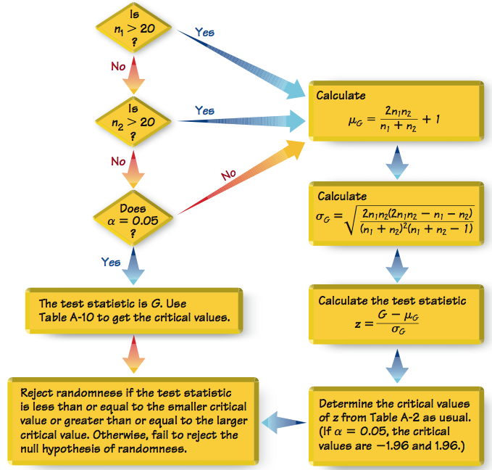
Procedure for Runs Test for Randomness

Slide 8
Objective
Apply the runs test for randomness to a sequence of sample data to test for randomness in the order of the data. Use the following null and alternative hypotheses.
H₀: The data are in a random sequence.
H₁: The data are in a sequence that is not random.

Slide 9
Notation
n₁ = number of elements in the sequence that have one particular characteristic (The characteristic chosen for n₁ is arbitrary.)
n₂ = number of elements in the sequence that have the other characteristic
G = number of runs

Slide 10
Requirements
1. The sample data are arranged according to some ordering scheme, such as the order in which the sample values were obtained.
2. Each data value can be categorized into one of two separate categories (such as male/female).

Slide 11
Runs Test for Randomness
For Small Samples (n₁ ≤ 20 and n₂ ≤ 20) and α = 0.05:
Test Statistic
Test statistic is the number of runs G
Critical Values
Critical values are found in Table A-10.

Slide 12
Runs Test for Randomness
For Small Samples (n₁ ≤ 20 and n₂ ≤ 20) and α = 0.05:
Decision criteria
Reject randomness if the number of runs G is:
less than or equal to the smaller critical value found in Table A-10.
or greater than or equal to the larger critical value found in Table A-10.

Slide 13
Runs Test for Randomness
For Large Samples (n₁ > 20 and n₂ > 20) and α = 0.05:
Test Statistic
where
and

Slide 14
Runs Test for Randomness
For Large Samples (n₁ > 20 or n₂ > 20) or α ≠ 0.05:
Critical Values
Critical values of z: Use Table A-2.

Slide 15
Runs Test for Randomness
For Large Samples (n₁ > 20 and n₂ > 20) and α = 0.05:
Decision criteria
Reject randomness if the test statistic z is:
less than or equal to the negative critical z score (such as –1.96).
or greater than or equal to the positive critical z score (such as 1.96).

Slide 16
Example: Small Sample: Genders of Study Participants
Listed below are the genders of the first 15 subjects participating in the “Freshman 15” study with results listed in Data Set 3 in Appendix B. Use a 0.05 significance level to test for randomness in the sequence of genders.
M M M M F M F F F F F M M F F
Requirements are satisfied, so separate the runs as shown below.
M M M M F M F F F F F M M F F
3rd run
1st run
2nd run
4th run
5th run
6th run

Slide 17
Example: Small Sample: Genders of Study Participants
M M M M F M F F F F F M M F F
1st run
2nd run
3rd run
4th run
5th run
6th run
n₁ = total number of males = 7
n₂ = total number of females = 8
G = number of runs = 6
Because n₁ ≤ 20 and n₂ ≤ 20 and α = 0.05, the test statistic is G = 6

Slide 18
Example: Small Sample: Genders of Study Participants
M M M M F M F F F F F M M F F
1st run
2nd run
3rd run
4th run
5th run
6th run
From Table A-10, the critical values are 4 and 13.
Because G = 6 is neither less than or equal to the critical value of 4, nor is it greater than or equal to the critical value of 13, we do not reject randomness.
It appears the sequence of genders is random.

Slide 19
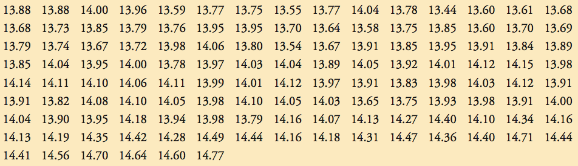
Example: Large Sample: Global Warming
Requirements are satisfied. Here are the hypotheses:
H₀: The sequence is random.
H₁: The sequence is not random.

Slide 20
Example: Large Sample: Global Warming
The mean of the 126 temperatures is 13.998ºC. The test statistic is obtained by first finding the number of temperatures below the mean and the number of temperatures above the mean. Examination of the sequence results in these values:
n₁ = number of temperatures above mean = 68
n₂ = number temperatures below mean = 58
G = number of runs = 32

Slide 21
Example: Large Sample: Global Warming
Since n₁ > 20, calculate z using the formulas:

Slide 22
Example: Large Sample: Global Warming
With significance level α = 0.05 and a two-tailed test, the critical values are z = –1.96 and 1.96.
The test statistic of z = –5.69 falls within the critical region, so we reject the null hypothesis of randomness. The given sequence does appear to be random.
Claims of global warming appear to be supported by the data - see the minitab display.

